Slide 1
Digital Portfolio Project
▶ Name: M.Sathyan
▶ Reg. No and NMID:24133101802521045 andE1F7E4523AF730C91EA415F53A7D2CD4
▶ Department: B. Sc. Computer Science
▶ College: Government Arts and Science College, kallakurichi
▶ University: Annamalai University

Slide 2
Project Title
▶Student digital portfolio using html, css and java script

Slide 3
AGENDA
▶ 1.Problem Statement
▶ 2.Project Overview
▶ 3.End Users
▶ 4.Tools and Technologies
▶ 5.Protfolio design and Layout
▶ 6.Features and Functionality
▶ 7.Results and Screenshots
▶ 8.Conclusion
▶ 9.Github Link

Slide 4
PROBLEM STATEMENT
▶ Traditional resumes and static portfolios lack interactivity, personalization, and a modern showcase of skills.
▶ There is a need for a dynamic, responsive digital portfolio to highlight projects, skills, and experiences.

Slide 5
Project Overview
▶ A responsive web-based digital portfolio designed to present personal and professional information.
▶ Includes sections: About, Skills, Projects, Experience, and Contact.

Slide 6
End Users
▶ Recruiters and Hiring Managers
▶ Clients seeking freelance developers
▶ Collaborators and Professional network

Slide 7
Tools and Techonologies
▶ Frontend: HTML5, CSS3,JavaScript
▶ Frameworks: React (planned) Next.js
▶ Backend: Nods.js, Express
▶ Database: MongoDB, PostgreSQL
▶ Tools: GitHub, Docker, Figma

Slide 8
Portfolio Design and Layout
▶ Clean, modern design with responsive UI
▶ Sections: Hero, About, Skills, Projects, Experience, Contact
▶ Interactive navigation and smooth scrolling
▶ Accessible and mobile-friendly

Slide 9
Features and Functionality
▶ Animated counters for experience, project, and stacks
▶ Reveal animations on scroll
▶ Smooth scrolling with sticky header offset
▶ Contact form and external project links

Slide 10
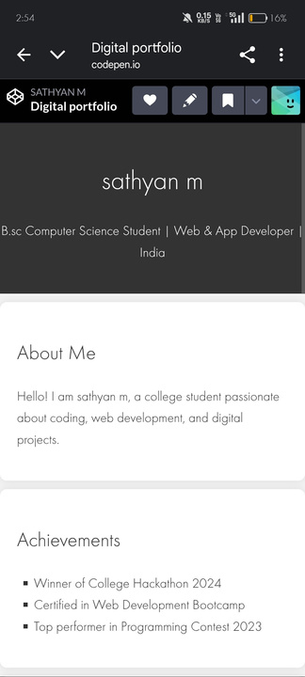
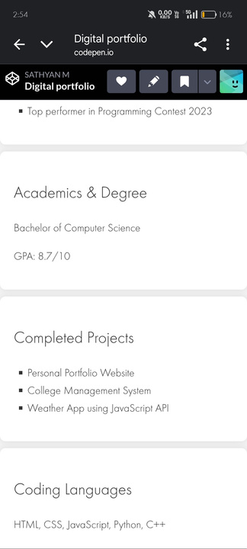
Results and Screenshots

Slide 11
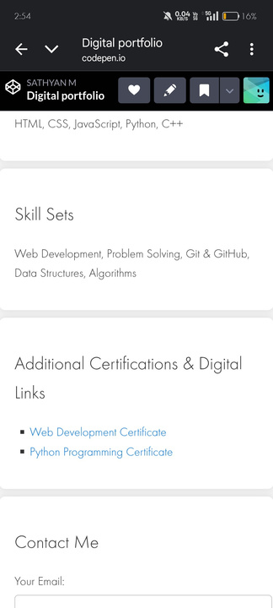
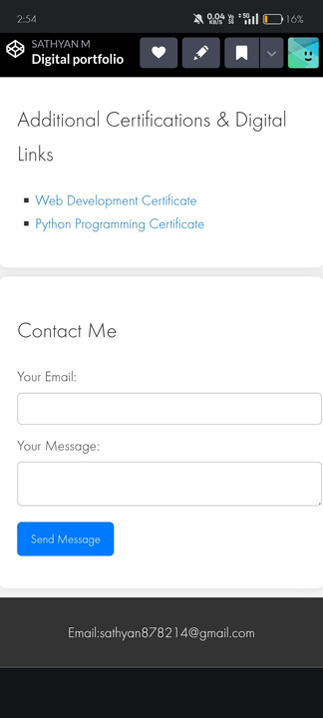
Results and Screenshots

Slide 12
Conclusion
▶ The digital portfolio effectively demonstrates skills, projects, and experiences in an engaging way.
▶ It improves visibility, accessibility, and professional presence
▶ Future enhancements: Blog integration, dark mode, and expanded project showcase.

